Slide 1
PBL - Week 3
Andreas Weitz

Slide 2
Life with 6000 Genes – Databases
Internet addresses mentioned in the paper:
ftp.mips.embnet.org -> The webiste is online, but without significant content except for ads
ftp.ebi.ac.uk -> Website is online and actively used (not the yeast part of it) but for me nothing wants to load on the page
genome-ftp.standford.edu -> Webiste ist offline
mips.biochem.mpg.de/yeast -> Webiste ist offline
sanger.ac.uk/yeast -> website online, but only data about yeast is under: sanger.ac.uk/data/yeast-data/

Slide 3
Life with 6000 Genes – Databases
genome.stanford.edu/Saccharomycotina -> standford.edu website is online, but genome.Stanford.edu is offline
expasy.hcuge.ch -> offline, but expasy still online
proteome.com -> offline
Ncbi.nlm.nih.gov -> online and actively used

Slide 4
Databases for Genes, Proteins and Genomes
ncbi.nlm.nih.gov (Library of Medicine — National Center for Biotechnology Information)
ensembl.org
ftp.ebi.ac.uk

Slide 5
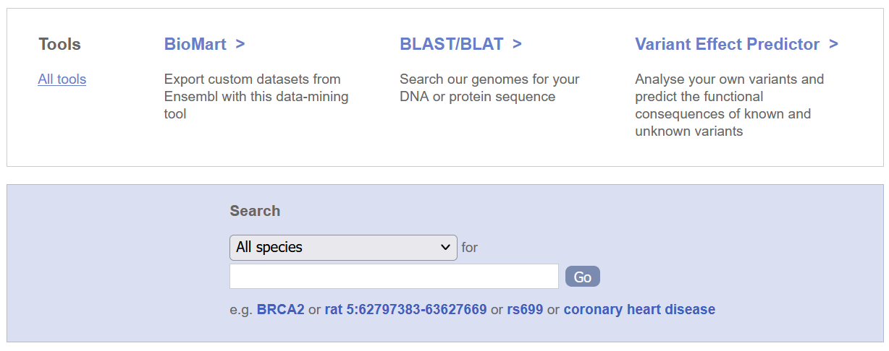
ensembl.org

Slide 6
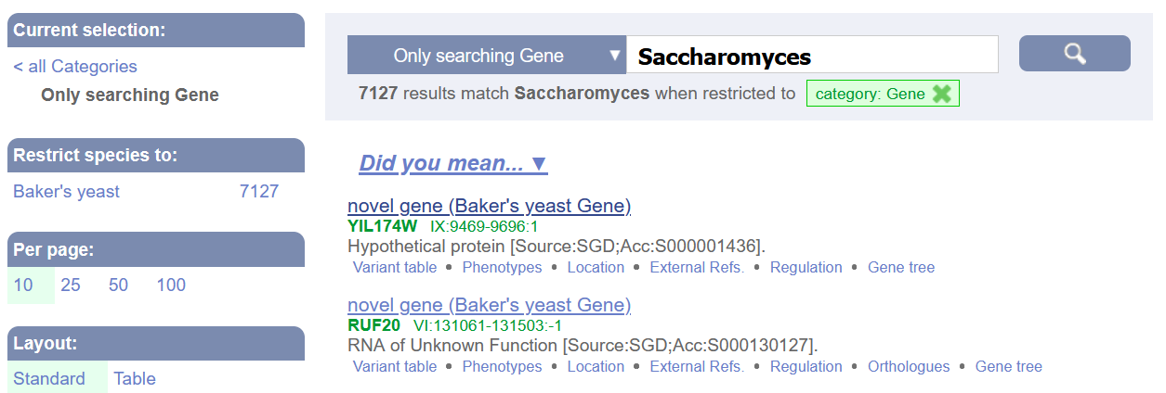
## ensembl.org

Slide 7
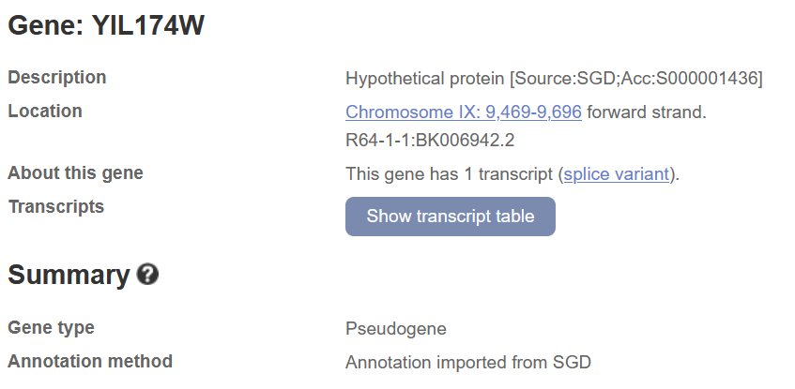
ensembl.org

Slide 8
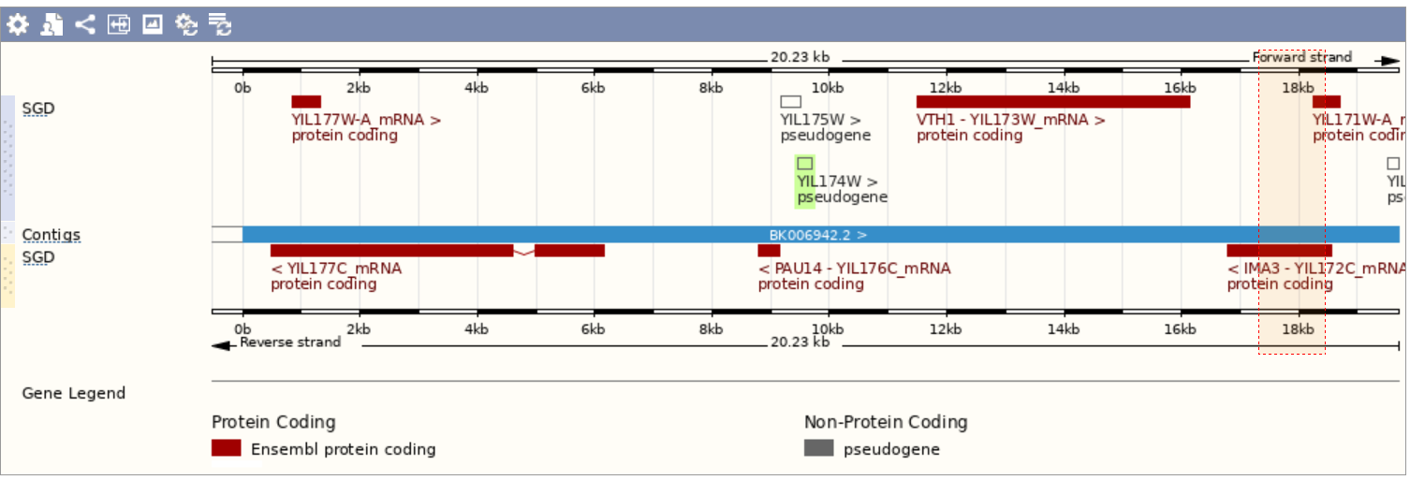
ensembl.org

Slide 9
ensembl.org

Slide 10
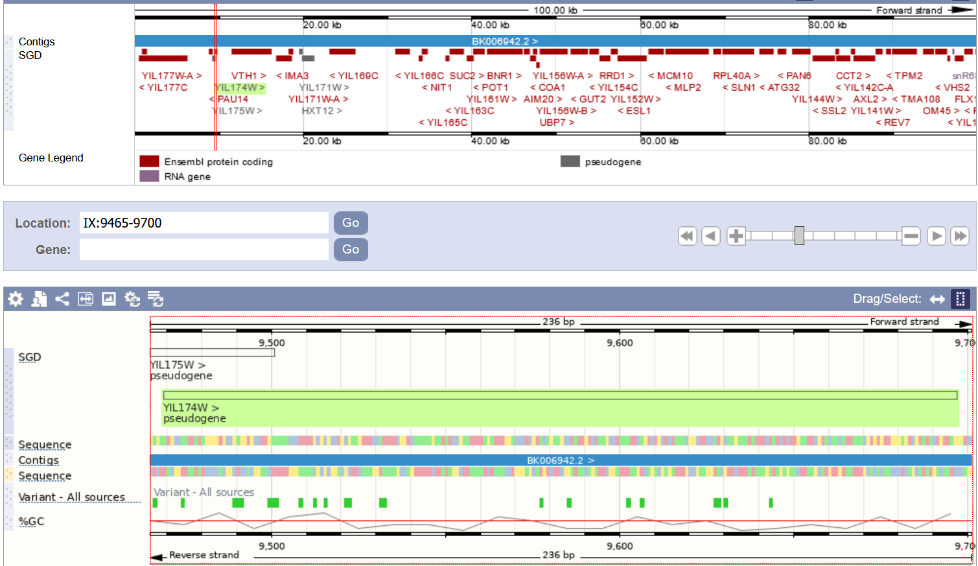
ensembl.org

Slide 11
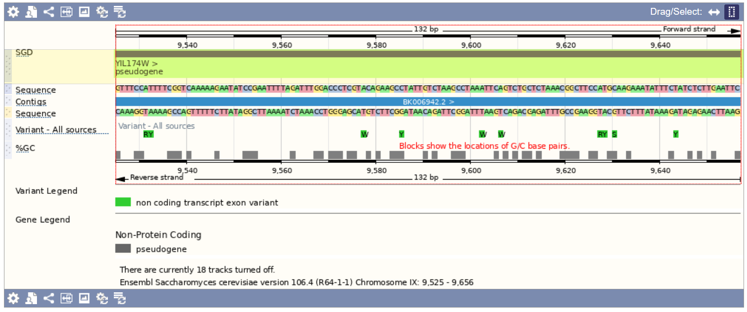
ensembl.org

Slide 12
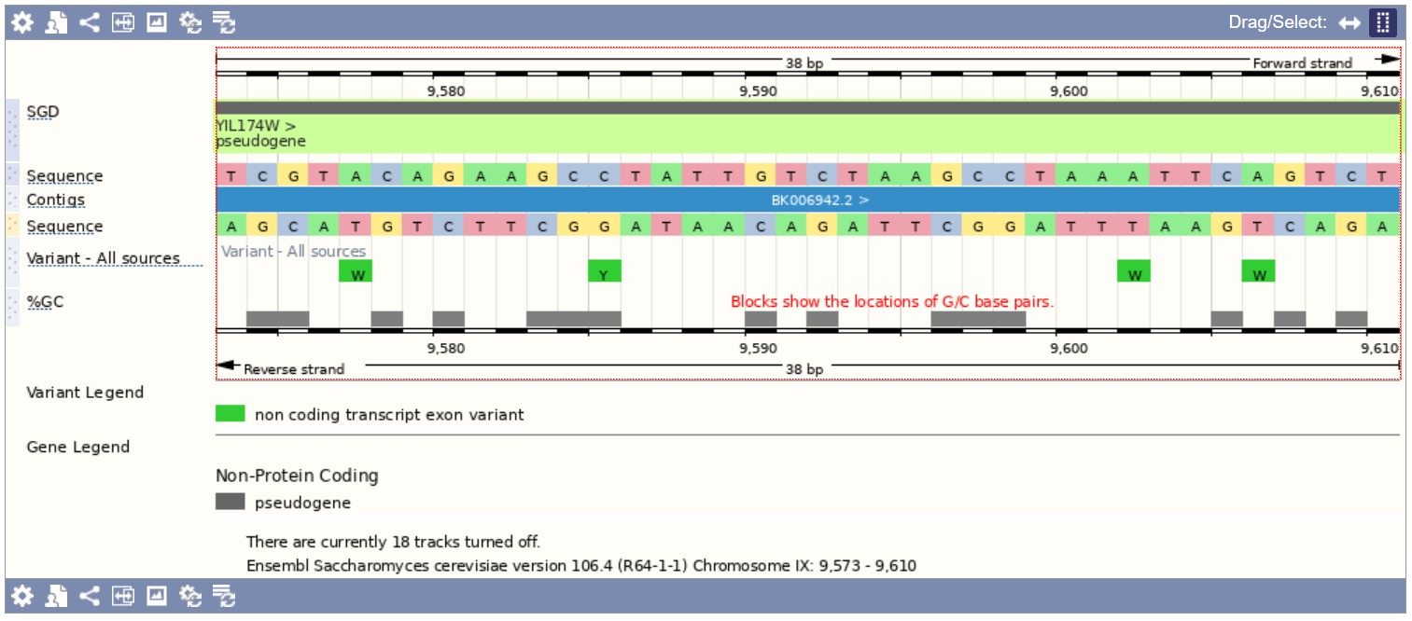
ensembl.org

Slide 13
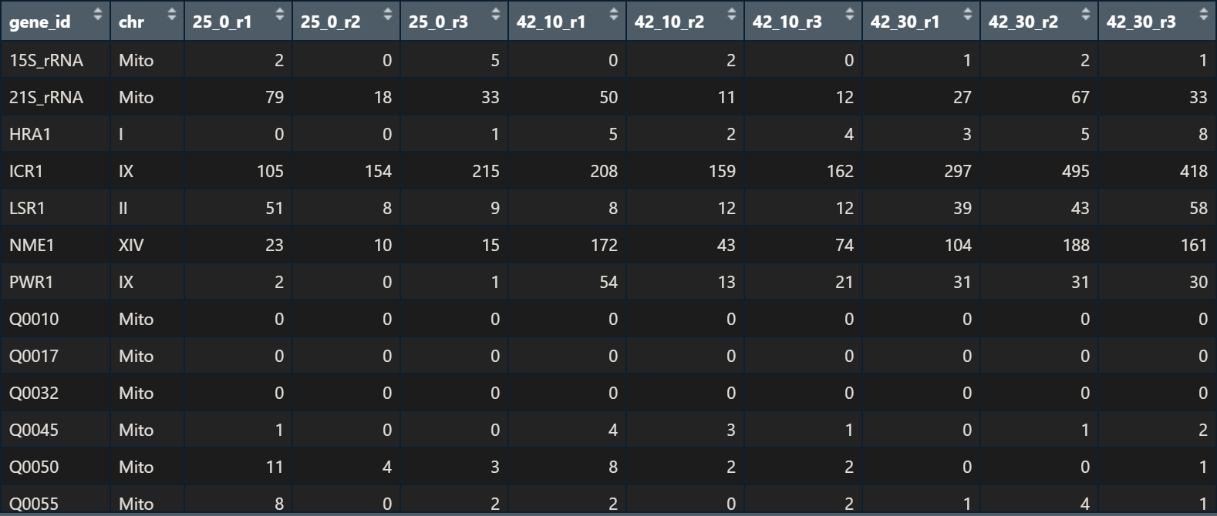
basic yeast heatshock
format of data

Slide 14
Three measurements were made at each temperature, r1, r2 and r3 respectively. They were performed for every different gene section (geneId) in the yeast gene.

Slide 15
Plot the data
{r, echo=FALSE} attach(basic_yeast_heatshock)
hist(log2(basic_yeast_heatshock$25_0_r1))
Problem: Error in plot.new() : figure margins too large Solution:
par(mar = c(1, 1, 1, 1)) hist(log2(basic_yeast_heatshock$25_0_r1))
##Plot the data
25_0_r1 <- basic_yeast_heatshock$25_0_r1 par(mar = c(1, 1, 1, 1)) hist(25_0_r1)
Nicht sehr aussagekräftig
##Plot the Data
25_0_r1 <- 25_0_r1 par(mar = c(1, 1, 1, 1)) hist(log2(25_0_r1))

